Slide 1
Certificate-Based Authentication using Easy-RSA on Ubuntu EC2
Prepare by : Parasharama

Slide 2
certificate-based authentication using Easy-RSA on an Ubuntu EC2 instance
Certificate Authentication using Easy-RSA is a security method where users and servers prove their identity using digital certificates instead of passwords.
Easy-RSA is a tool that helps you create your own Certificate Authority (CA) and generate server certificates, client certificates, and keys that are used by systems like OpenVPN for secure, encrypted communication.

Slide 3
Why it is used
To create secure VPN connections (OpenVPN)
To ensure that only trusted clients can connect
To provide stronger security than username/password
To allow encryption + authentication using PKI (Public Key Infrastructure)
Key components involved
CA (Certificate Authority) → Main authority that signs certificates
Server certificate → Used by the server to identify itself
Client certificate → Used by each client to authenticate
Private key → Secret key (never shared)
Public certificate → Shared with server/client
CRL (Certificate Revocation List) → Used to block a compromised client certificate

Slide 4
Steps to Create Certificates Using
Easy-RSA
Step 1: Create EC2 instance
Create one EC2 Instance with Ubuntu Application and OS Images (Amazon Machine Image)
Use the old version of AMI Ubuntu Server 22.04 LTS (HVM),EBS General Purpose (SSD) Volume Type, & don’t use the latest Version of AMI
Key pair : add .ppk file

Slide 5
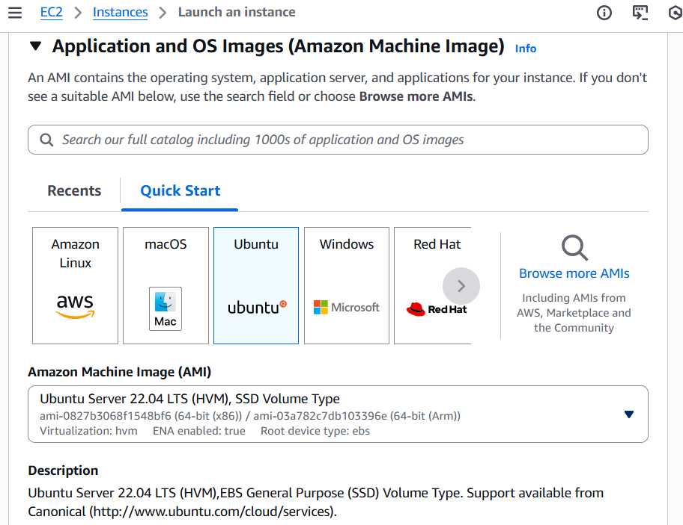

Slide 6
Step 2: Conncet EC2 Instance ( HOW )
Using PuTTY (Windows)
- Windows users normally use PuTTY (since it uses .ppk keys).
1 Convert .pem → .ppk
Open PuTTYgen
Click Load → choose your .pem file
Click Save private key → saves .ppk
Close PuTTYgen
2 Open PuTTY
Hostname = ubuntu@<EC2-PUBLIC-IP>
Go to Connection > SSH > Auth > Credentials
Browse and add your .ppk key
Click Open & Accept the connection
3 Connect Using EC2 Instance Connect (Web Browser)
Open AWS Console → EC2 → Instances
Select your instance & click to “Connect”
This opens an in-browser terminal.

Slide 7
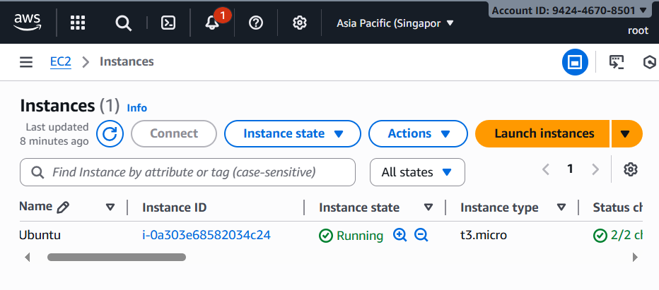

Slide 8
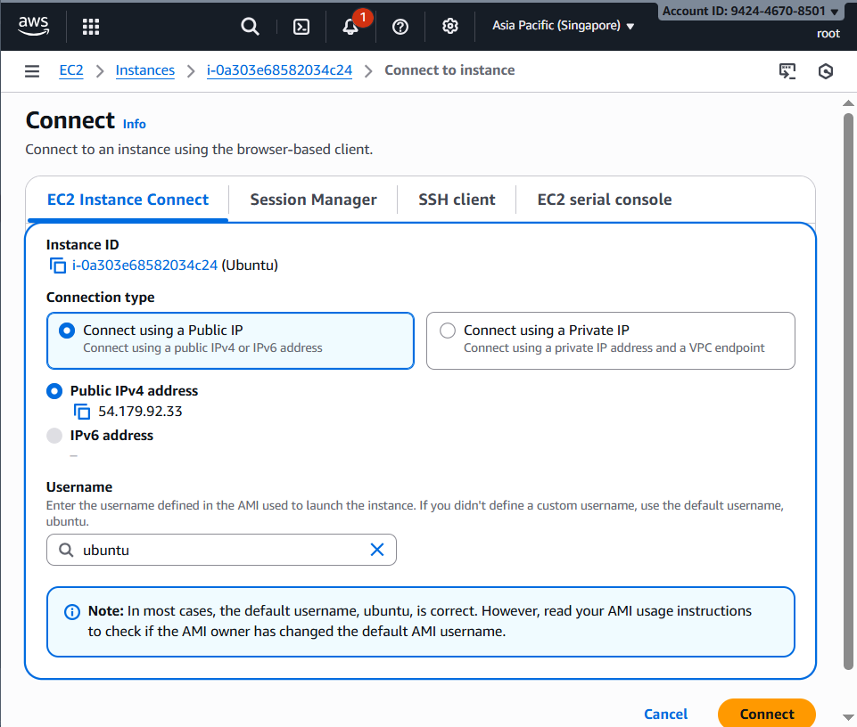

Slide 9
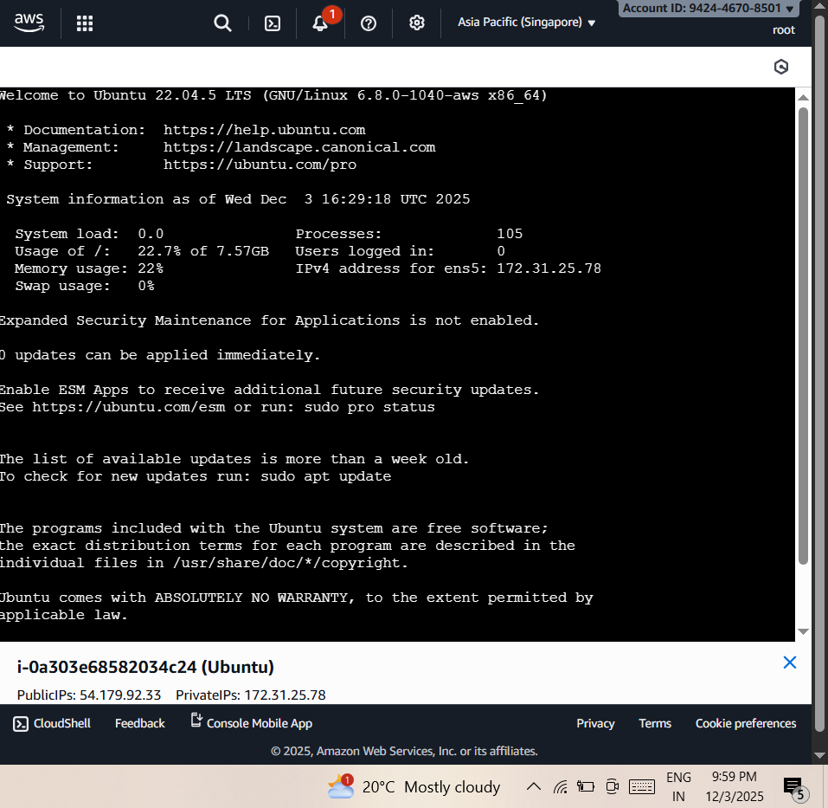
Successful Connected to Ubuntu

Slide 10

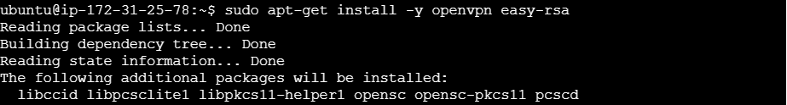
In terminal Install Easy-RSA and OpenVPN tools & run commands
Step 3: sudo apt-get update # Every to time to update when you connect
Step 4: sudo apt-get install -y openvpn easy-rsa
  What this command does
  Installs OpenVPN
    OpenVPN server & client software
    Used to create secure VPN tunnels
  Installs Easy-RSA
    Tool to create certificates (CA, server cert, client certs)
    Helps generate keys and sign certificates
  -y flag
    Automatically selects YES for installation
    No need to confirm manually

Slide 11

Step 5: make-cadir ~/easy-rsa
  make-cadir is a script used in Easy-RSA version 2 (old version).
  It creates a new Easy-RSA working directory where you will manage keys and certificates.
  It copies all Easy-RSA template files into ~/easy-rsa directory.
  - /home/ubuntu/easy-rsa
    This path contain the your CA, server certificate, client certificates, keys, DH parameters, CRL, etc.
    Step 6: cd ~/easy-rsa
      It will redirect the Directory to folder

Slide 12
      Step 7: Initialize PKI (Public Key Infrastructure)
      - ./easyrsa init-pki
Creates a new folder named pki/
This is where all certificates, keys, CA, CRL, DH will be stored.
Folder structure created:
  pki/
  ├── private/
  ├── reqs/
  ├── issued/
  ├── ca.crt (later)
  ├── dh.pem (later)
  └── crl.pem (later)

Slide 13
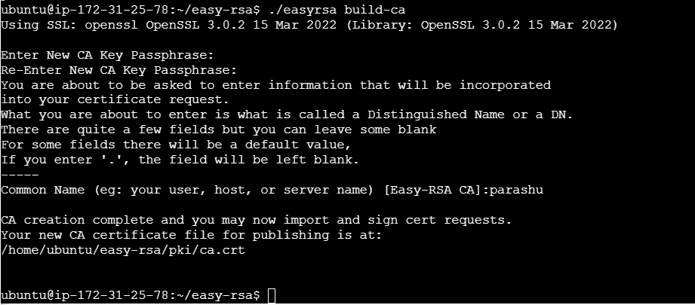
Step 8: Build the Certificate Authority (CA)
- ./easyrsa build-ca
Once u run this cmd then you need to create New Password & You can store this password future reference (ubuntu123)
- Create the new your user, host name / server name : parashu

Slide 14
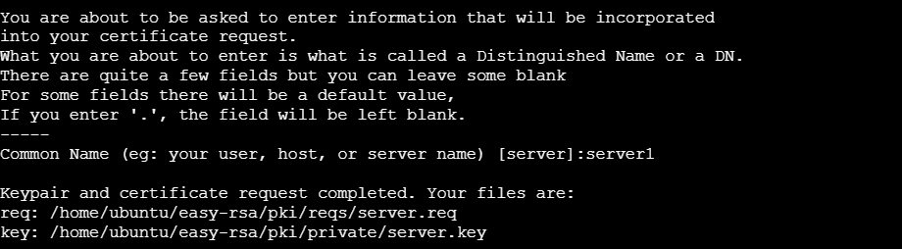
Step 9: Generate Server Certificate Request
  cmd: ./easyrsa gen-req server nopass
  Creates a private key + certificate signing request (CSR)
  Created files: pki/private/server.key & pki/reqs/server.req Because of nopass, the server key will not have a password (common for servers).
  Once you run cmd then it ask server name : server1
  Ofter it will show the path of directory

Slide 15
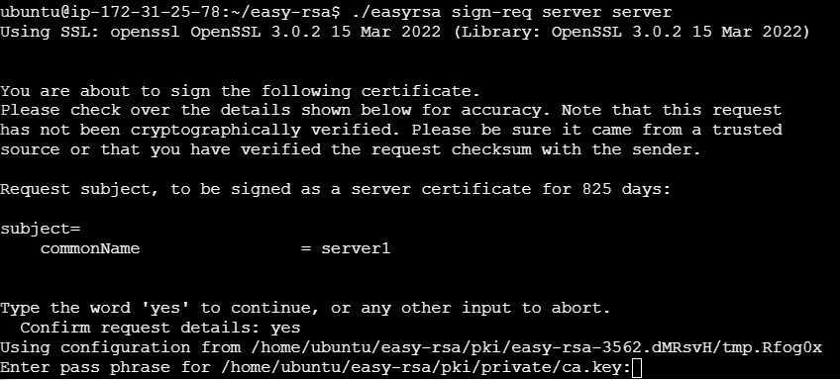
Step 10: Sign request to the Server Certificate with CA
  Cmd: ./easyrsa sign-req server server1
    Purpose:
    Signs the server’s CSR using CA
    Generates: server.crt → Server certificate
    This certificate is required by OpenVPN server to authenticate itself.
It Will ask to enter the password : ubuntu123

Slide 16
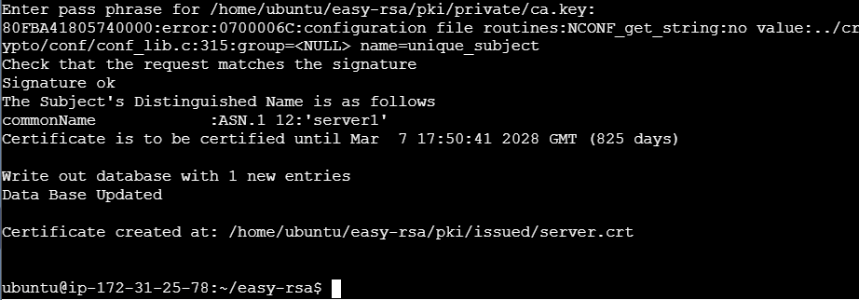
Once you enter valid password then it will create the Certificate
Once you enter valid password then it will create the Certificate
And it also show the Certificate validate information up-to 825 days and year
Once you create the Certificate no need to create another certificate just you can use copy this certificate and past it to any server authentication

Slide 17
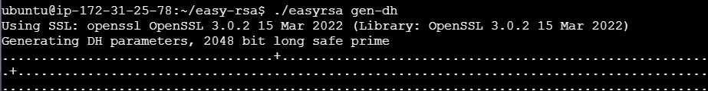
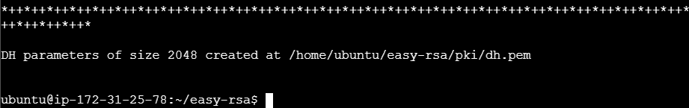
Step 11: Generate Diffie-Hellman parameters ( dh )
-cmd: ./easyrsa gen-dh
  What it does dh
  Creates pki/dh.pem
  Used for secure key exchange in OpenVPN
  Required for older OpenVPN configurations (for TLS handshake)
  It also show the path where it created

Slide 18
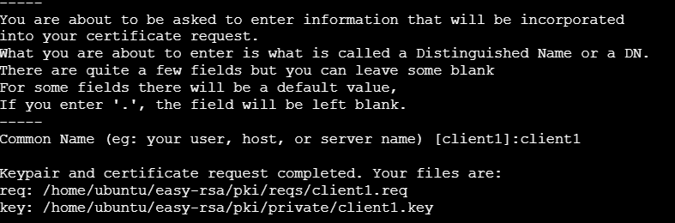
Step 12: Generate Client Certificate Request
  - cmd: ./easyrsa gen-req client1 nopass
You can give the any client name : client1

Slide 19
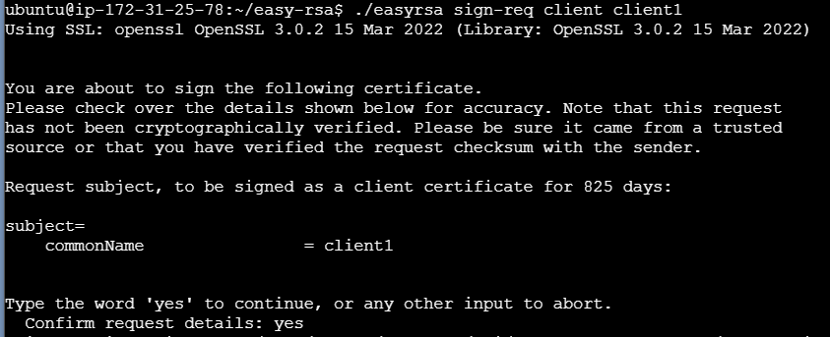
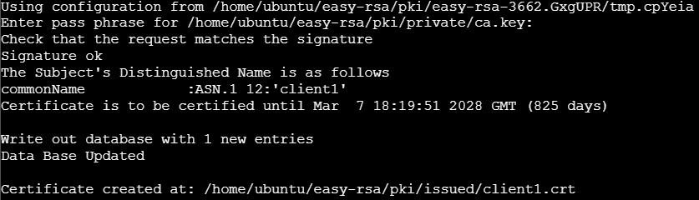
Step 13: Now Generate Client Certificate Request
  - cmd: ./easyrsa sign-req client client
client
- It will ask enter the password when you created server password that password you need to enter

Slide 20
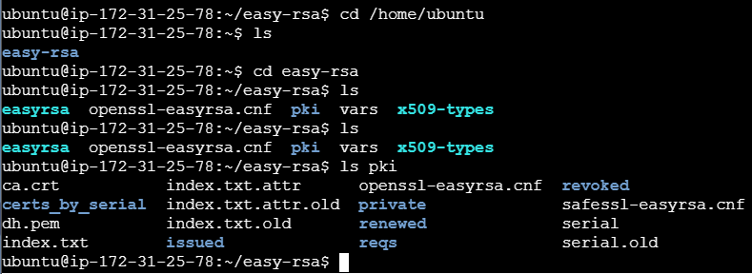
You can check easy-rsa file

Slide 21
Using .PPK file in WinSCP
Steps to use the singapore.ppk private key in WinSCP:
  1. Open WinSCP and click 'New Site'.
  2. Set File protocol to SFTP.
  3. Enter your EC2 Public IP in Host name.
  4. Set Username to 'ubuntu'.
  5. Click the 'Advanced...' button.
  6. Navigate to: SSH → Authentication.
  7. Click 'Browse' next to Private key file.
  8. Select singapore.ppk from your computer.
  9. Click OK → Save → Login.

Slide 22
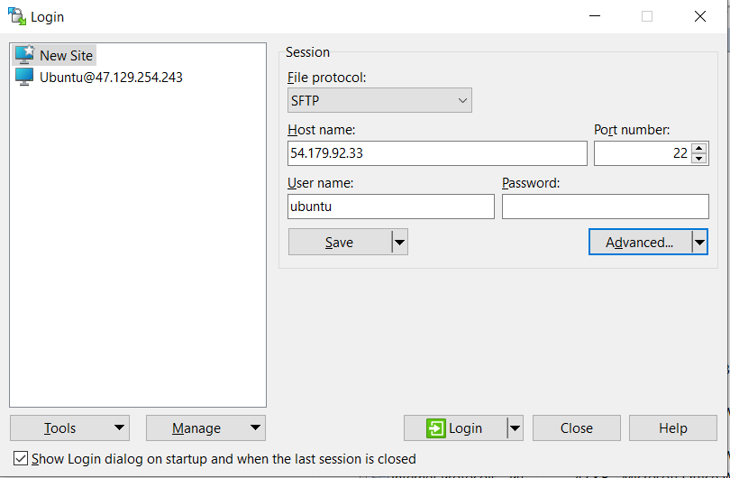
You can save the certificate for future reference you can one software to copy the certificate that is WinSCP
Download the WinSCP https://winscp.net/eng/download.php
Open WinSCP
Connect the Server : Go to EC2 instance copy the Public IPv4 Address

Slide 23
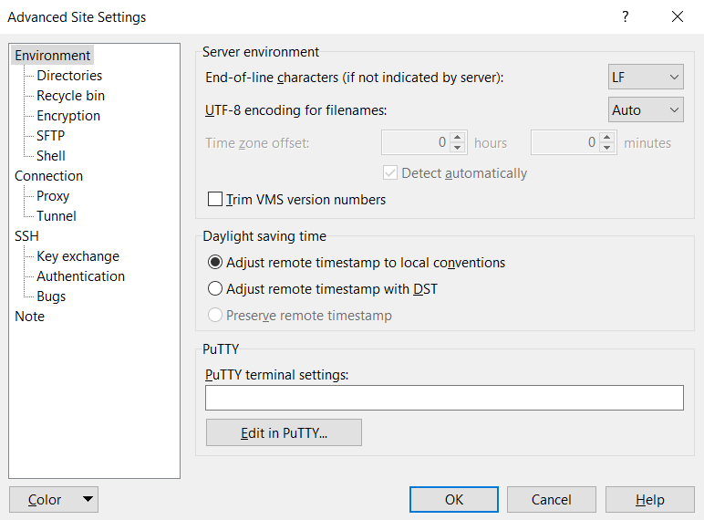
Then go-to Advanced + SSH + Authentication

Slide 24
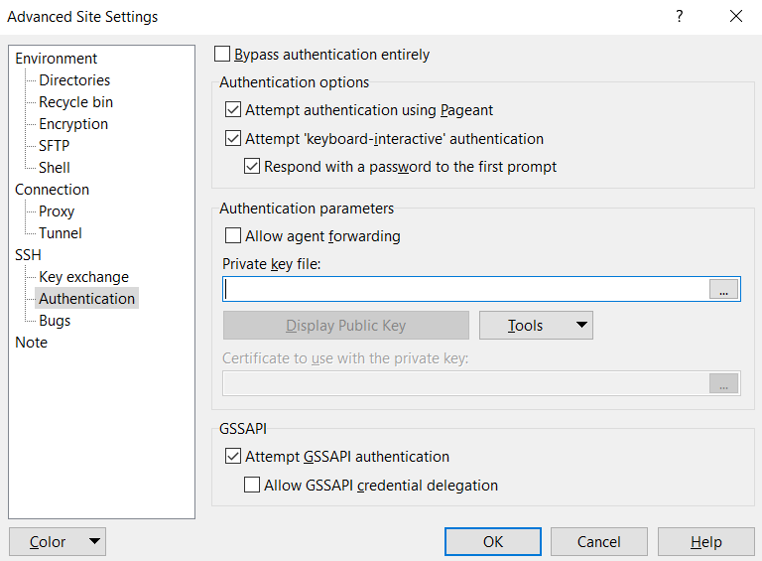
Add the private key file (.ppk file)

Slide 25
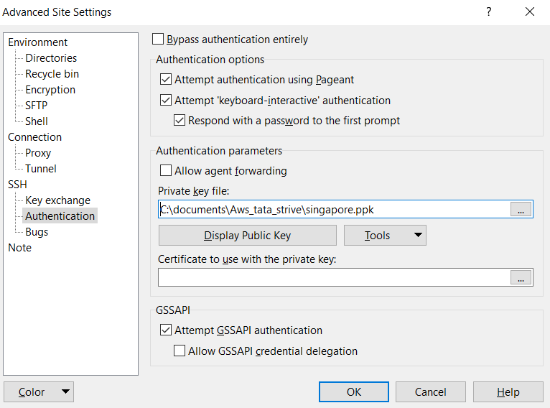
OK + Login +Accet

Slide 26
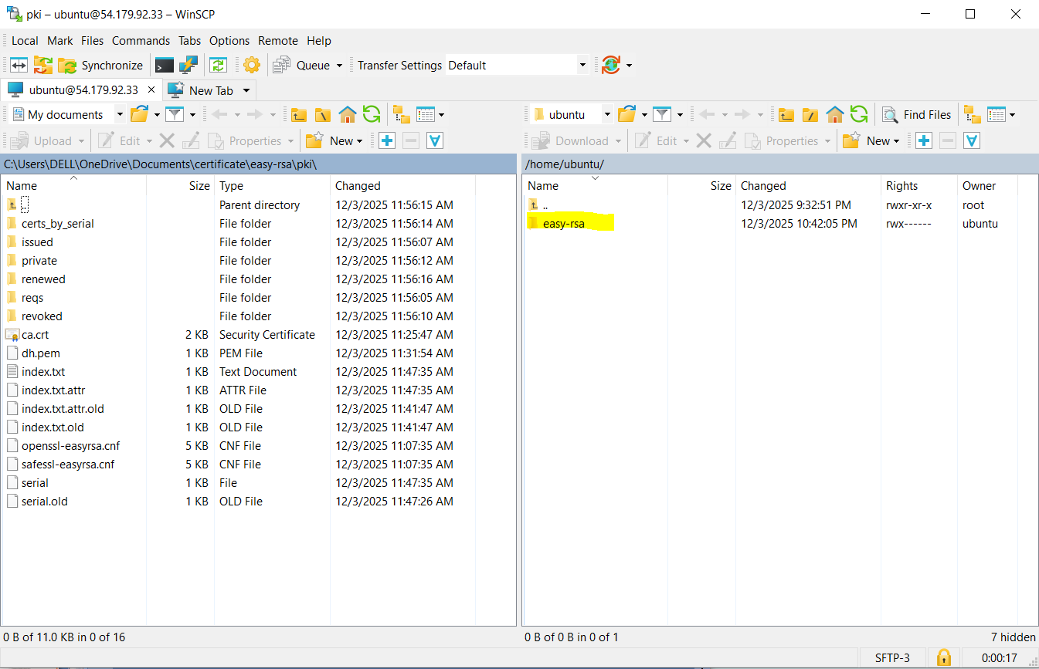
Go to easy-rsa +

Slide 27
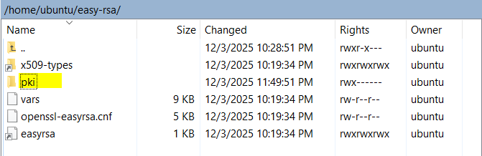
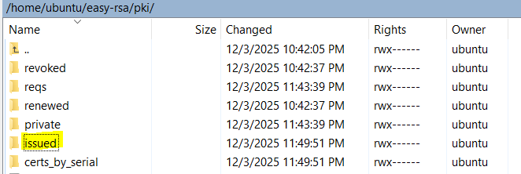
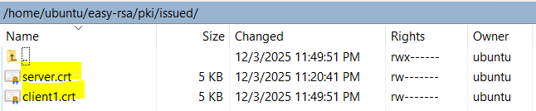
Go to easy-rsa + pki + issued then you see the both client and server certificates

Slide 28
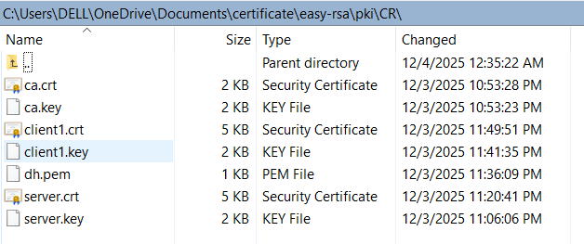
Now you can copy both client & server along with key certificate save it in any-where
Now you can use any time these cetificates

Slide 29
❗ If You Suddendly EC2 Instance Was Deleted BEFORE Saving Certificates !
When an EC2 instance is terminated:
All data inside the instance is permanently deleted
This includes:
  CA certificate + CA private key
  Server certificate & key
  Client certificate & key
  DH parameters
  CRL
  Entire Easy-RSA PKI folder (~/easy-rsa/pki)
❌ These files CANNOT be recovered
AWS does not keep backups of instance storage (unless you created a snapshot or AMI).

Slide 30
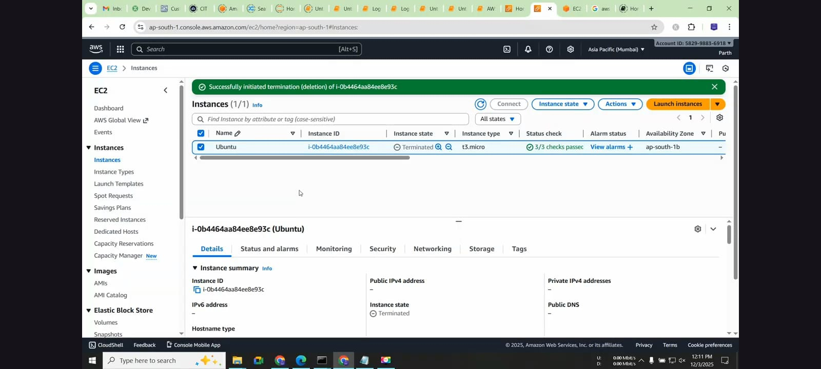
EC2 Instance deleted

Slide 31
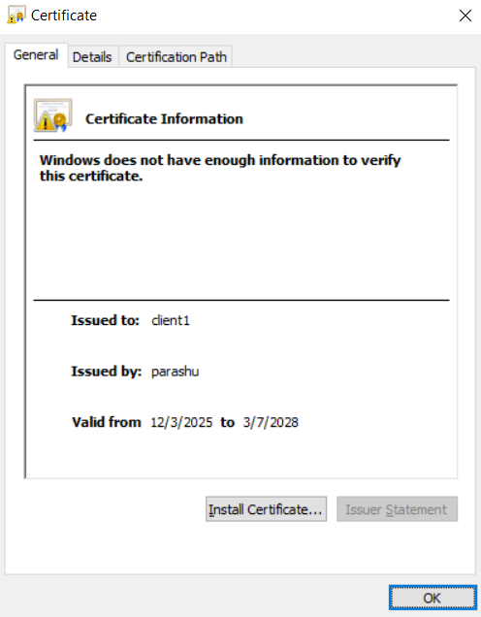
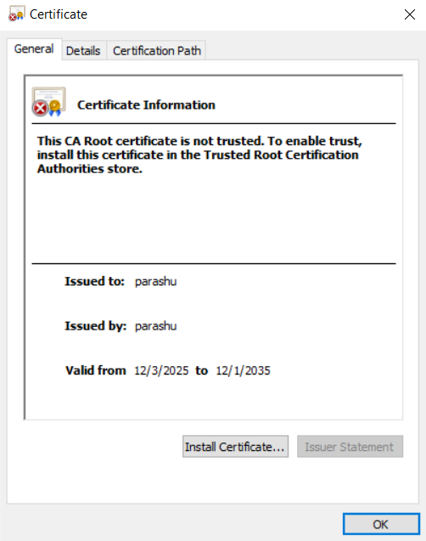

Slide 32
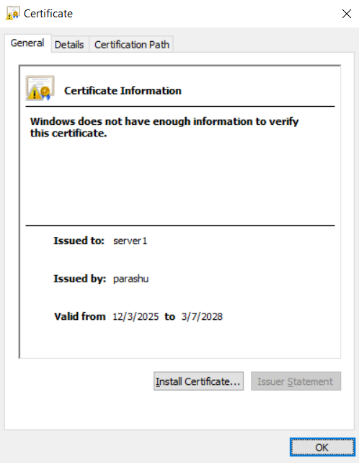

Slide 33
Thank You

